Slide 1
AR Platform
New Interaction Way
Dr. Tarek Salah Abdelazeem
Eng. Esraa Ezzat

Slide 2
Team
Abdelrahman Hamdy Abd Alrahiem
Abdelrahman Alarainy Mohamed
Mark Saeid Labib
Tarek Ayman Mohamed
Osama Mahmoud Mohamed
Ahmed Mohamed Ali
Omar Essam Mohamed
Mina Medhat Sabry

Slide 3
Agenda
1.
Introduction
2.
Background and Literature Survey
3.
Requirements and Analysis
4.
System Design
5.
Implementation
6.
Testing Phase
7.
Conclusion

Slide 4
1. Introduction

Slide 5


Problem Definition
Finding easier way to Interact with systems than using touch screen or keyboard or mouse
Notes:
https://pixabay.com/photos/architecture-building-amsterdam-1448221/

Slide 6
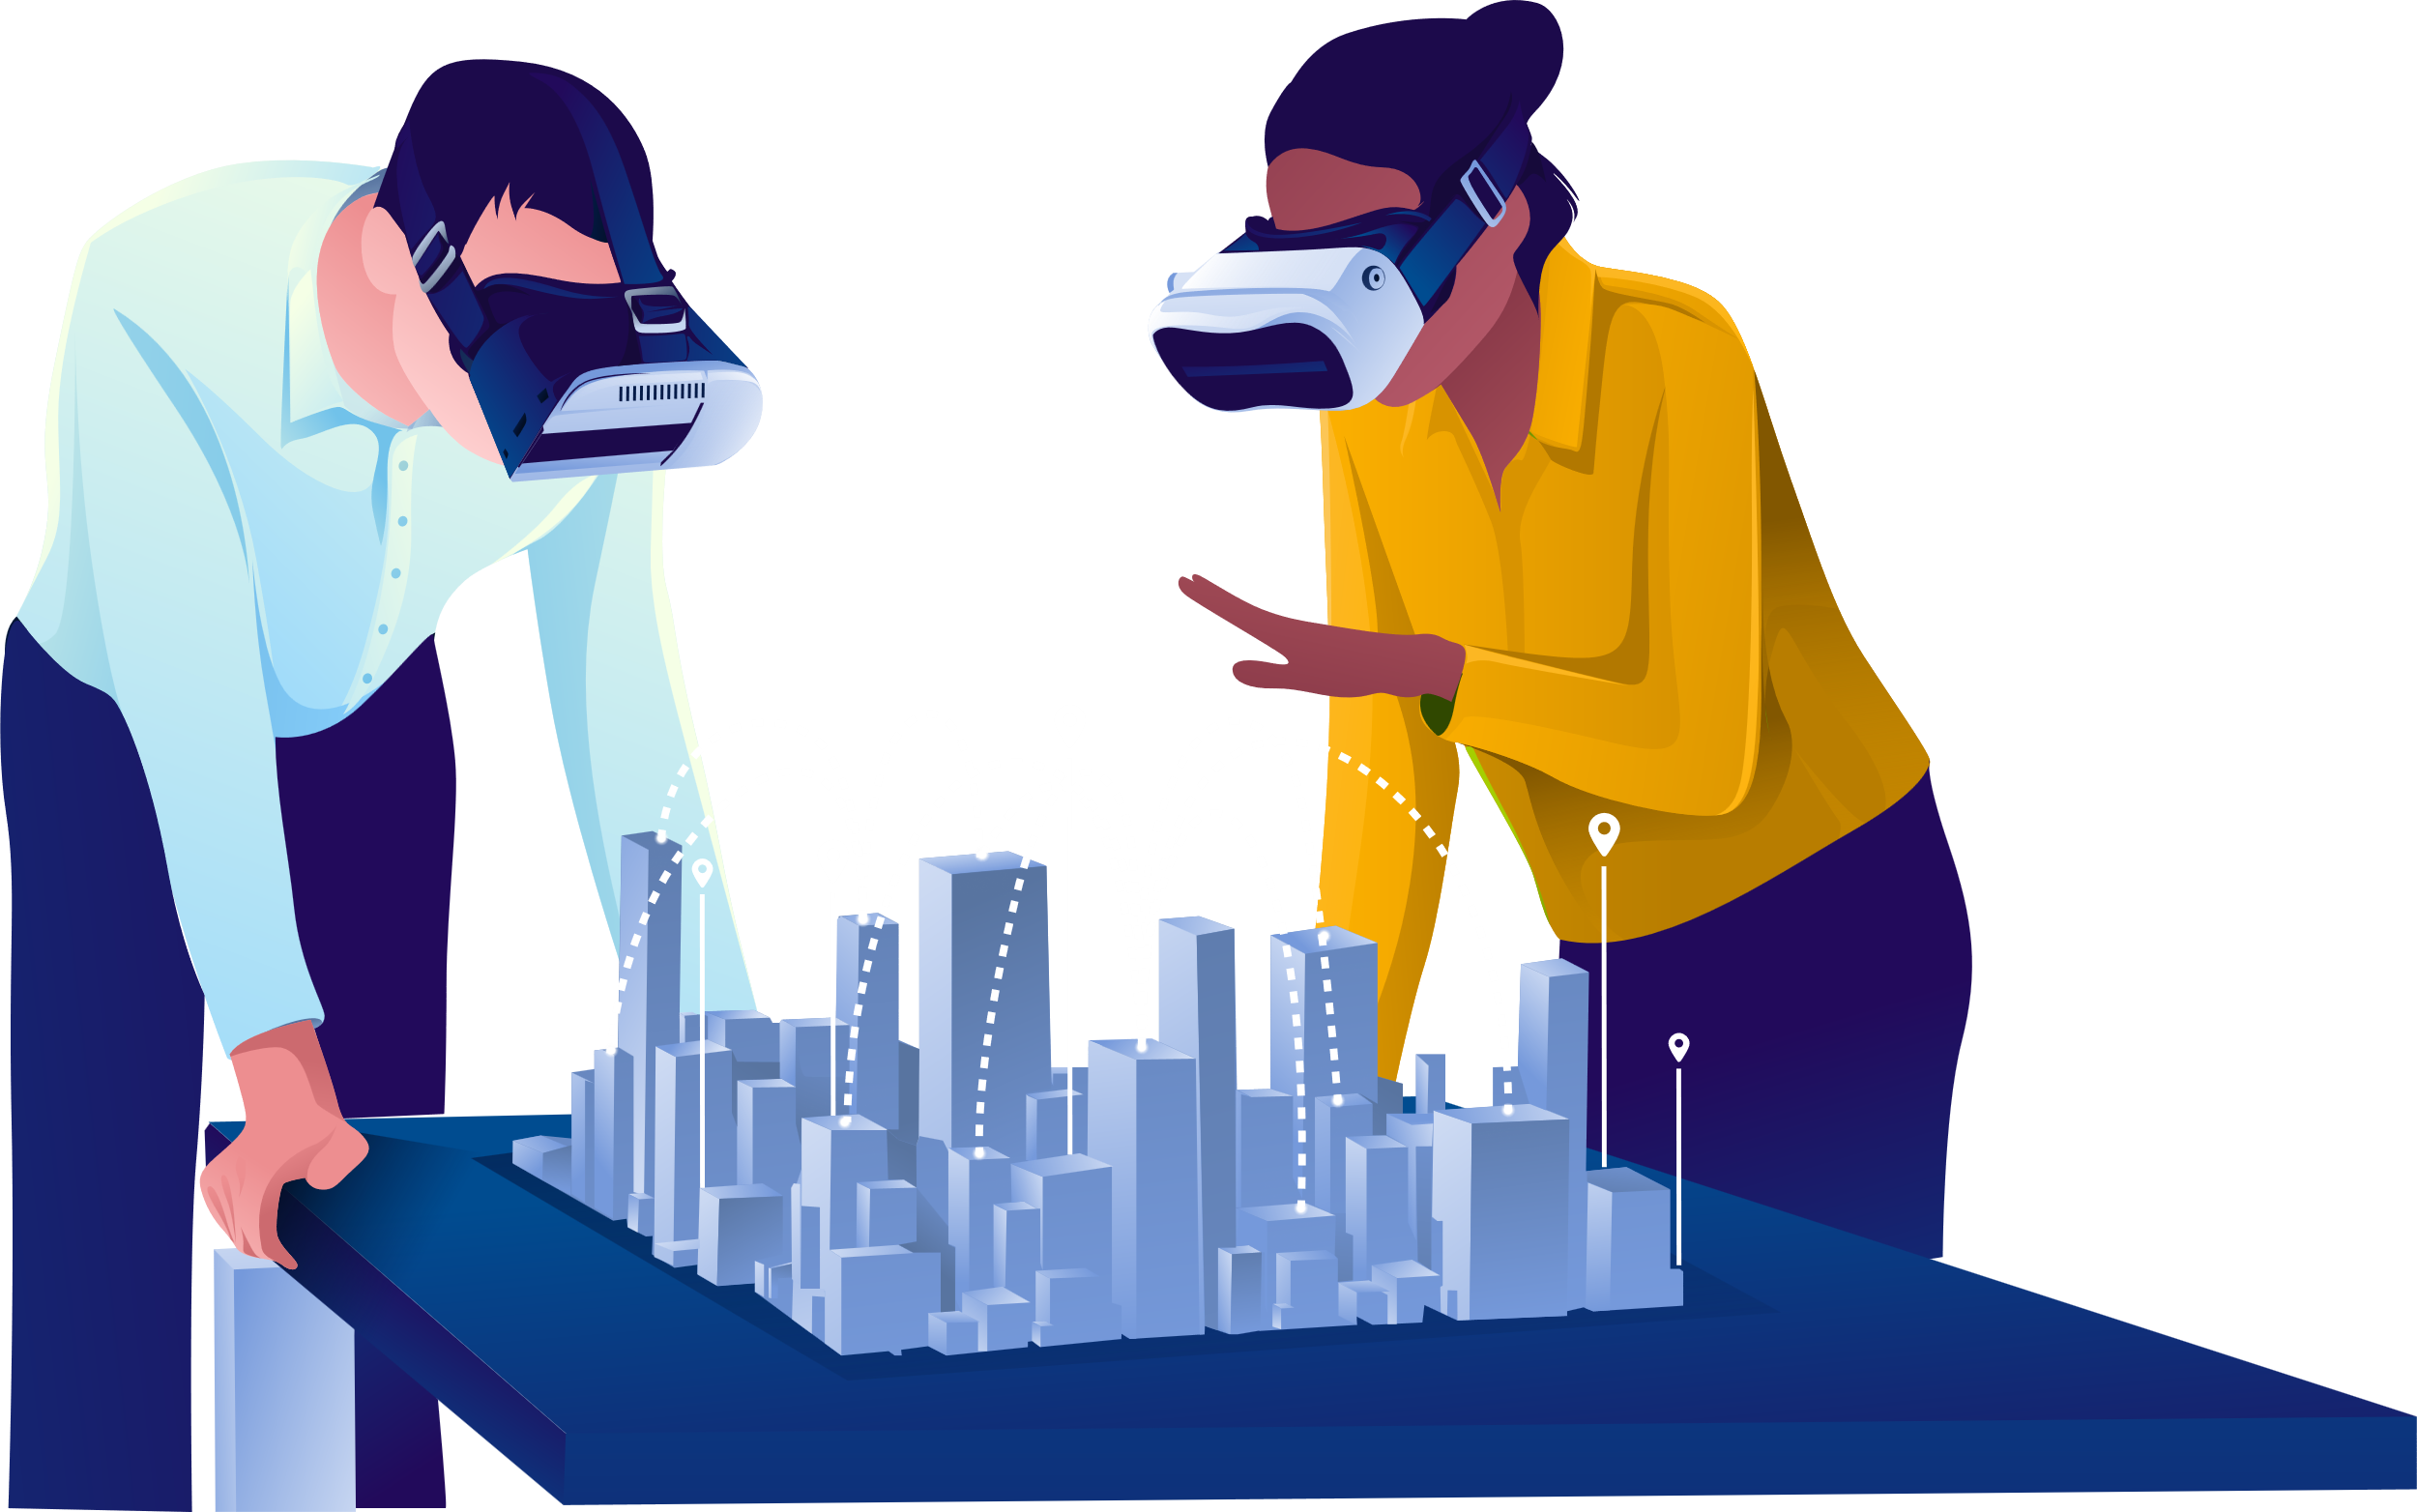
Objective
Provide augmented reality interface
Instead of touch screen or using keyboard, user can just use his hand gesture to control everything at the system
Add entertainment section such ad AR game
Provide ways to communicate with other such as chat
Make the UI more interesting for the user and easy to interact with

Slide 7
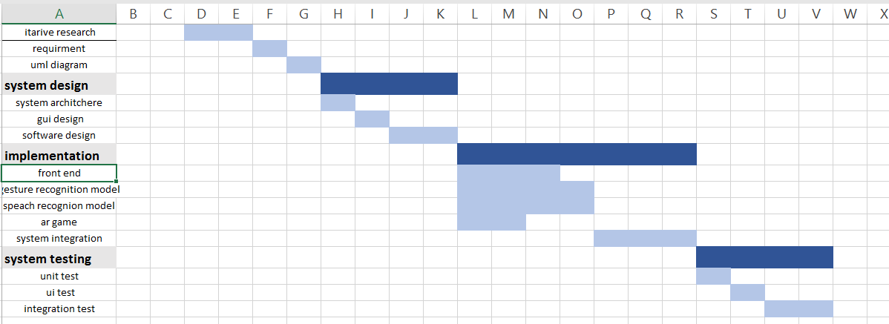
Expected Timeline

Slide 8
2. Background and Literature Survey

Slide 9
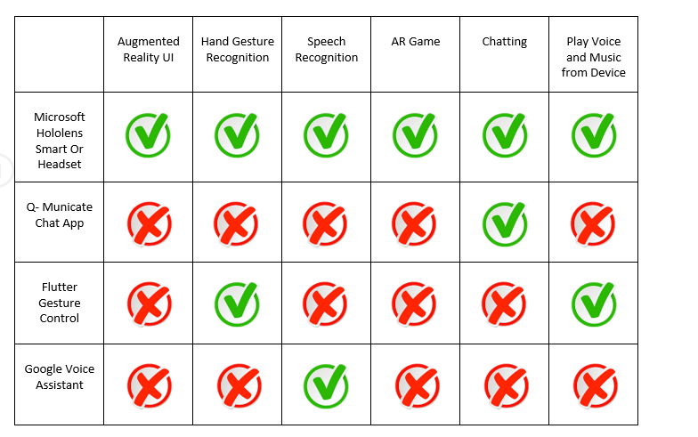
Similar Apps

Slide 10
Speech Recognition

Slide 12
Gesture Recognition

Slide 13
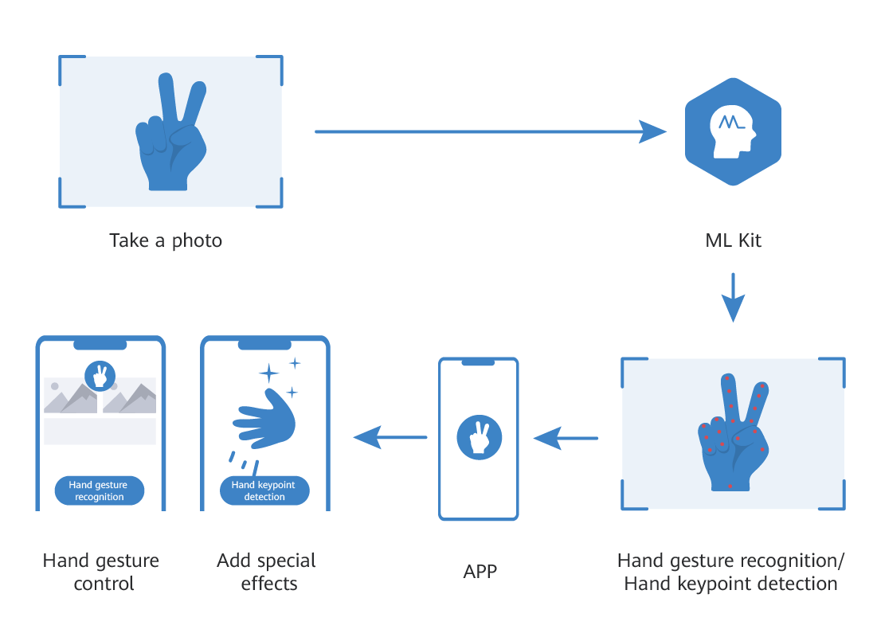
What is Gesture Recognition
Gesture recognition is a computing process that attempts to recognize and interpret human gestures using Deep learning model

Slide 14
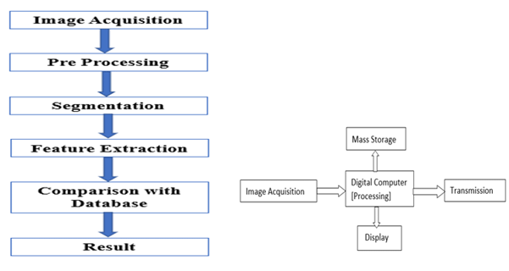
Steps
Image Acquisition
Image Acquisition is by means of a camera,
which captures images frame by frame.
Image Pre-processing
main function of this phase is to extract the hand image
from its background. It involves color filter, noise filter,
smex)thing and thresholding.
Feature Extraction
This finds and extracts features of hand image, Here
hand contour is used as a feature because contour contains
the necessary information on the object shape.

Slide 15
Papers comparison
Name | Real-time Hand Gesture Detection and Classification | Mini Gesture Detection Using Neural Networks Algorithms | MediaPipe Hands: On-device Real-time Hand Tracking
Publisher | Köpüklü Okan | Gunduz Ahmet | Kose Neslihan |Rigoll Gerhard | Norah Alnaim |and Maysam Abbod | Fan Zhang |Valentin Bazarevsky |Andrey Vakunov | Andrei Tkachenka |George Sung Chuo-Ling |Chang Matthias| Grundmann
Dataset | EgoGesture and NVIDIA Dynamic Hand Gesture Datasets | own dataset with video records | In-the-wild dataset In-house gesture dataset Synthetic dataset
Technique | Convolutional Neural Networks | Convolutional Neural Networks | _
Accuracy | 94.04% | 97.14% | 95.7%

Slide 16
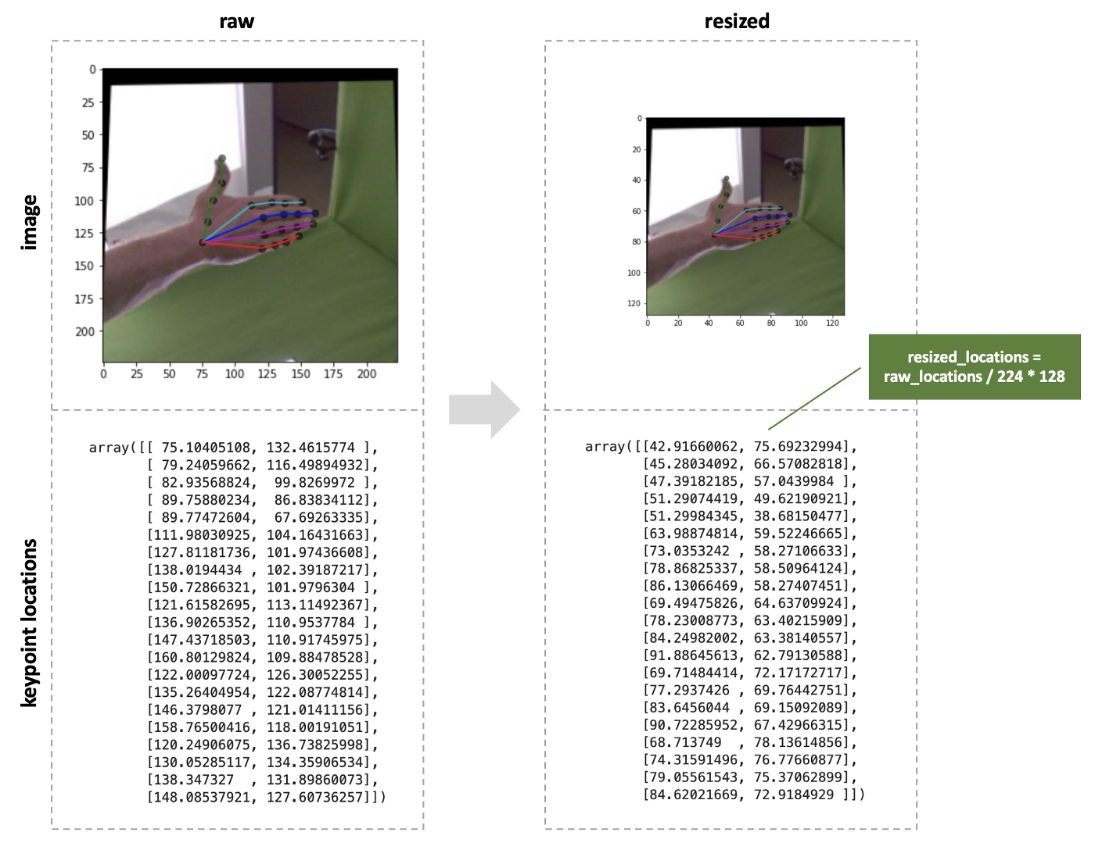
Prepossessing
1. Split the dataset into train ,validation , and test parts.
2. Resize images to 128×128 pixels. 3. Original image values are in range [0,255], Min-max scale them to be in range [0,1].
4. Standard normalize images using train set means and standard deviations.

Slide 17
Neural Network

Slide 18
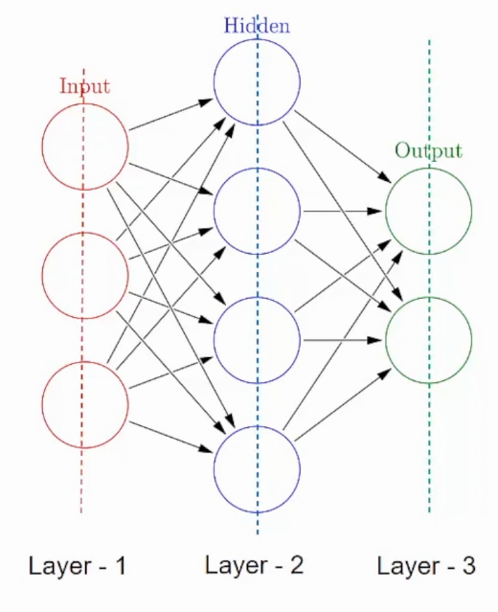
What are Layers in a Neural Network?
A neural network is made up of vertically stacked components called Layers. Each dotted line in the image represents a layer. There are three types of layers in a NN-

Slide 19
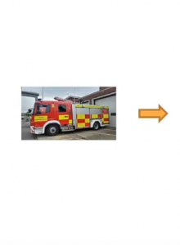
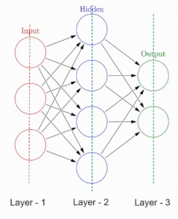
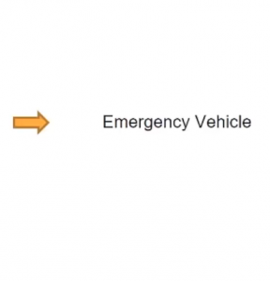
What are Layers in a Neural Network?
Input Layer– First is the input layer. This layer will accept the data and pass it to the rest of the network.
Hidden Layer– The second type of layer is called the hidden layer. They perform multiple functions at the same time such as data transformation, automatic feature creation, etc.
Output layer– The last type of layer is the output layer. The output layer holds the result or the output of the problem.

Slide 20
Techniques

Slide 21
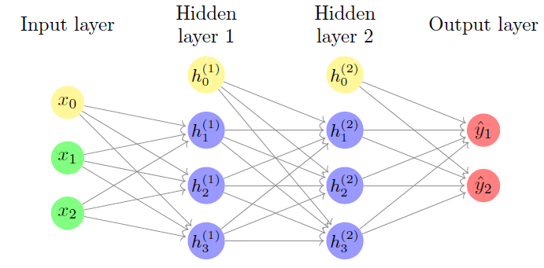
Artificial Neural Network
Artificial Neural Network (ANN), is a group of multiple perceptrons or neurons at each layer. ANN also known as a Feed-Forward Neural network because inputs are processed only in the forward direction.
This type of neural networks are one of the simplest variants of neural networks. They pass information in one direction, through various input nodes, until it makes it to the output node. The network may or may not have hidden node layers, making their functioning more interpretable.

Slide 22
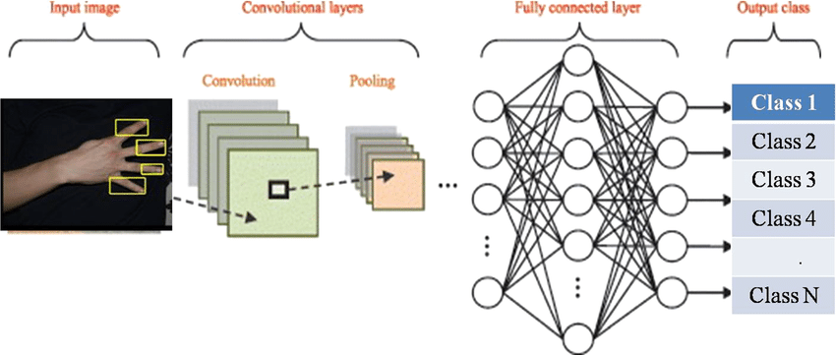
Convolutional Neural Network
Convolutional neural networks (CNN) are one of the most popular models used today. This neural network computational model uses a variation of multilayer perceptrons and contains one or more convolutional layers that can be either entirely connected or pooled. These convolutional layers create feature maps that record a region of image which is ultimately broken into rectangles and sent out for nonlinear processing.

Slide 23
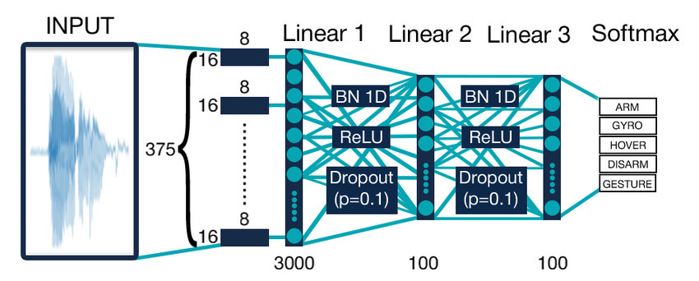
Recurrent Neural Network
Recurrent neural networks (RNN) are more complex. They save the output of processing nodes and feed the result back into the model (they did not pass the information in one direction only). This is how the model is said to learn to predict the outcome of a layer. Each node in the RNN model acts as a memory cell, continuing the computation and implementation of operations. If the network’s prediction is incorrect, then the system self-learns and continues working towards the correct prediction during backpropagation.

Slide 24
Comparison
 | ANN | CNN | RNN
Type of Data | Tabular Data, Text Data | Image Data | Sequence data
Performance | ANN is considered to be less powerful than CNN, RNN. | CNN is considered to be more powerful than ANN, RNN. | RNN includes less feature compatibility when compared to CNN.
Main advantages | Having fault tolerance, Ability to work with incomplete knowledge. | High accuracy in image recognition problems, Weight sharing. | Remembers each and every information, Time series prediction.
Disadvantages | Hardware dependence, Unexplained behavior of the network. | Large training data needed, don’t encode the position and orientation of object. | Gradient vanishing, exploding gradient.

Slide 25
Convolutional Neural Network

Slide 26
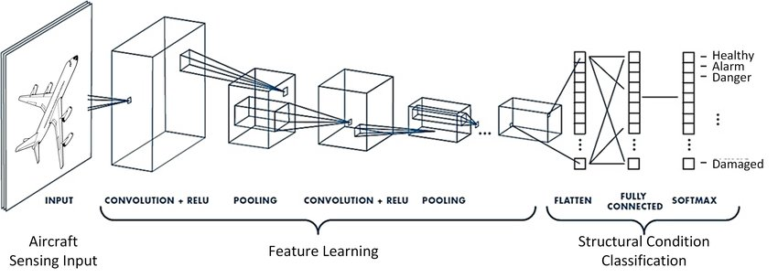
Principle
A convolutional neural network (CNN) is a type of artificial neural network used in image recognition and processing that is specifically designed to process pixel data.

Slide 27
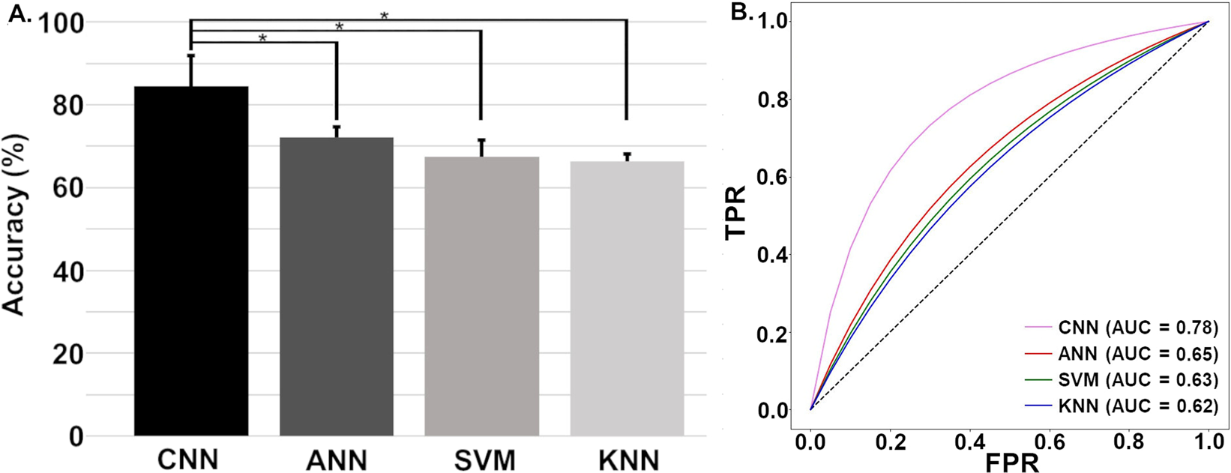
Advantages
Data over fitting avoided; a sub network improves classification accuracy considerably. Better performance achieved.

Slide 28

Layers
Convolutional Layer
Pooling Layer.
Fully Connected Layer.
Dropout.
Activation Function

Slide 29
Convolutional Layer
About :
This layer is the first layer that is used to extract the various features from the input images.
Output :
Feature map which gives us information about the image such as the corners and edges. Later, this feature map is fed to other layers to learn several other features of the input image.

Slide 30
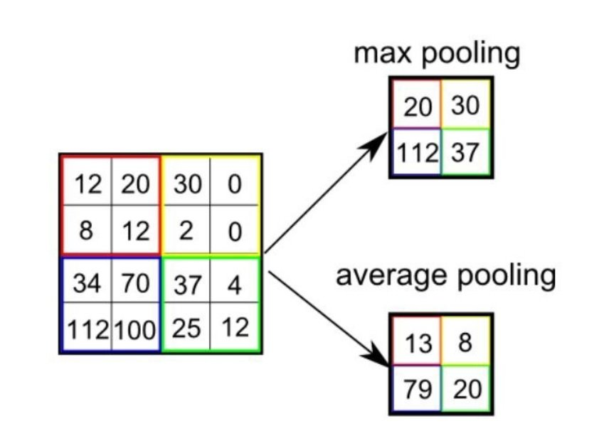
Pooling Layer
About :
The primary aim of this layer is to decrease the size of the convolved feature map to reduce the computational costs.
Output :
Decreased sized feature map . (Flattened)

Slide 31
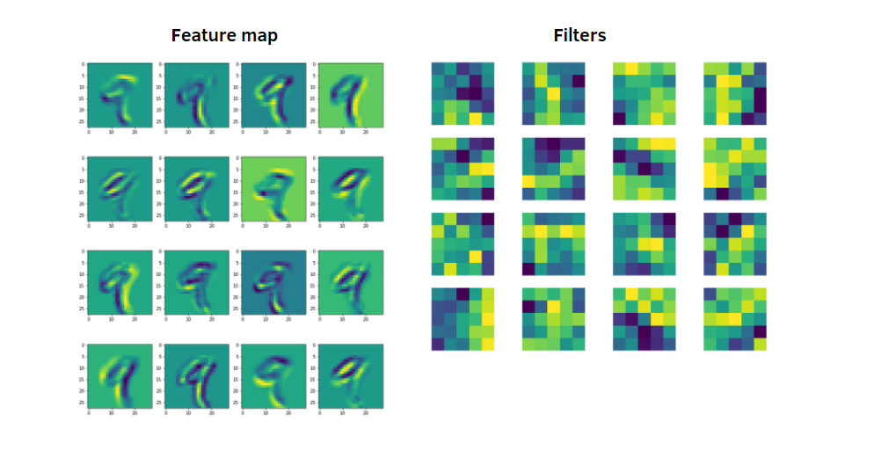
Fully Connected Layer
About :
The Fully Connected (FC) layer consists of the weights and biases along with the neurons and is used to connect the neurons between two different layers.
Output :
Feature map which gives us information about the image such as the corners and edges.

Slide 32
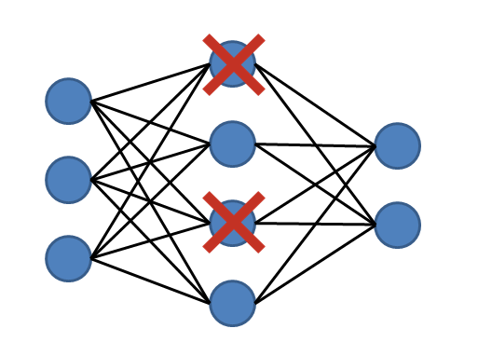
Dropout
About :
when all the features are connected to the FC layer, it can cause overfitting in the training dataset. Overfitting occurs when a particular model works so well on the training data causing a negative impact in the model’s performance when used on a new data.
On passing a dropout of 0.3, 30% of the nodes are dropped out randomly from the neural network.
Occurs in model train phase

Slide 33
Activation Functions
About :
it decides which information of the model should fire in the forward direction and which ones should not at the end of the network.
It can make overfitting

Slide 34
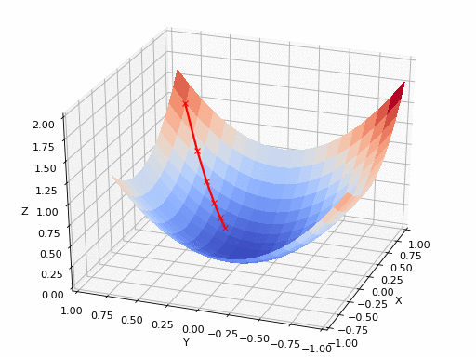
Optimization Algorithm
About :
Optimization is the process where we train the model iteratively that results in a maximum and minimum function evaluation. It is one of the most important phenomena in Machine Learning to get better results.

Slide 35
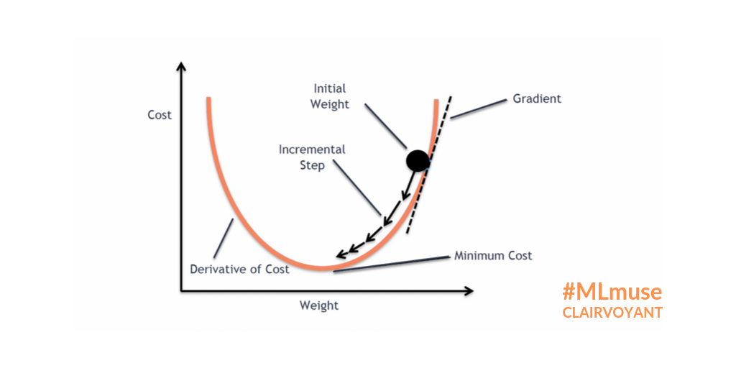
Gradient Descent
an optimization algorithm that's used when training a machine learning model. It's based on a convex function and tweaks its parameters iteratively to minimize a given function to its local minimum.
(for decreasing loss function)

Slide 36
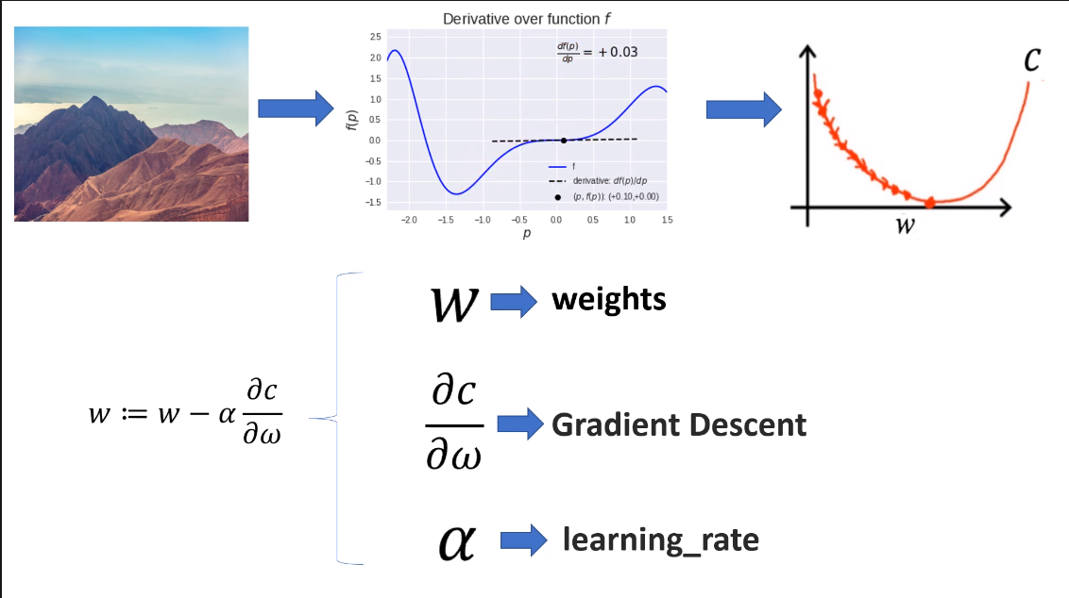

Slide 37
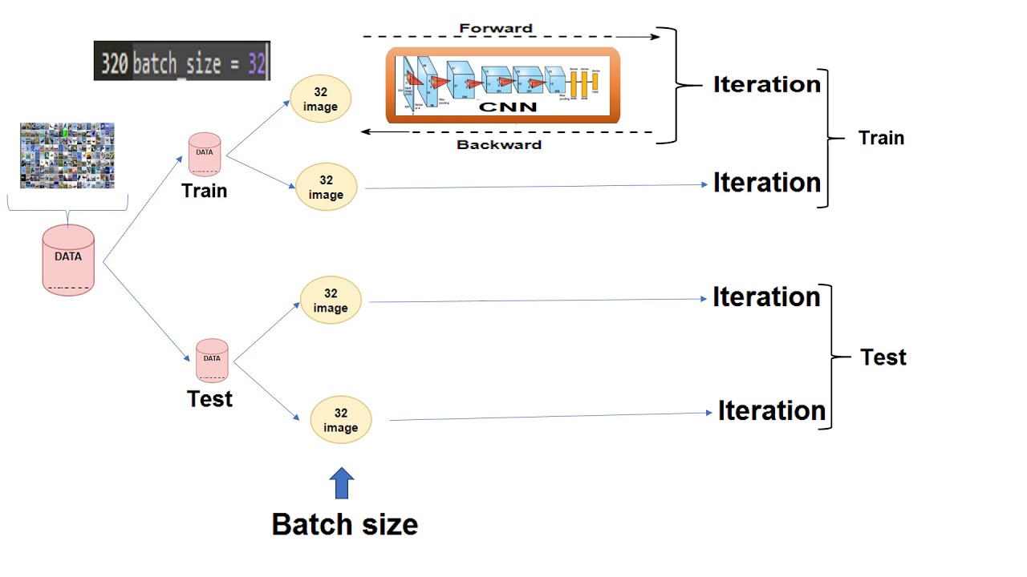

Slide 38

Model Output

Slide 39
Data Set
Frei HAND Dataset
3960 evaluation samples. Each training sample provides:
RGB image (224x224 pixels)
Hand segmentation mask (224x224 pixels)
Hand scale (metric length of a reference bone)
3D key point annotation for 21 Hand Key points
D shape annotation

Slide 40
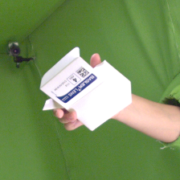
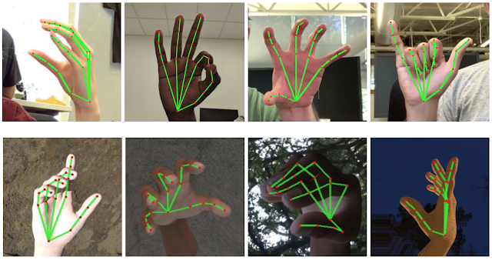
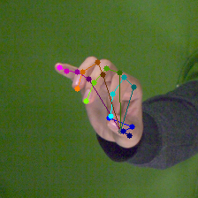
Dataset Samples

Slide 41
What is game engine ?

Slide 42


Slide 43
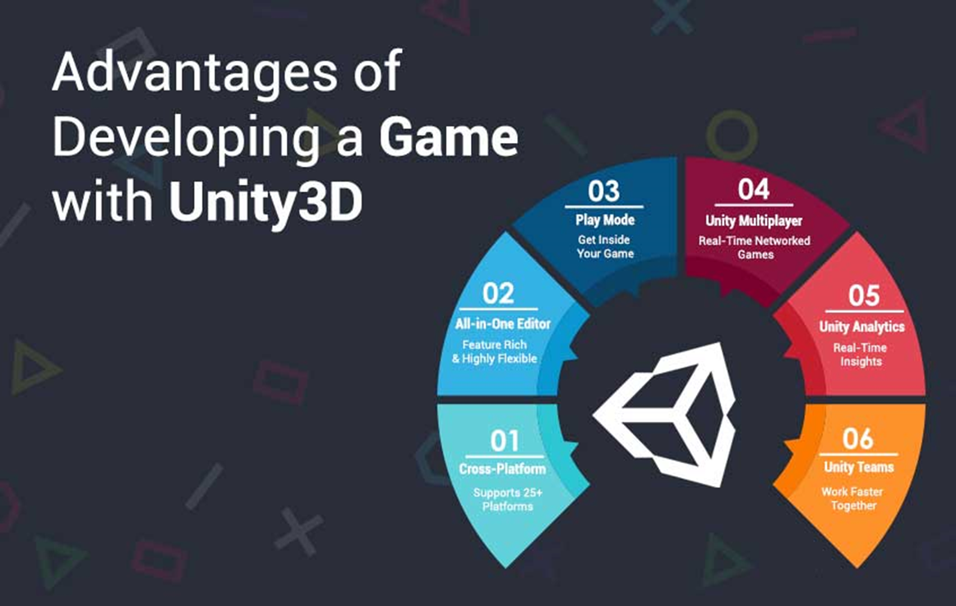

Slide 44
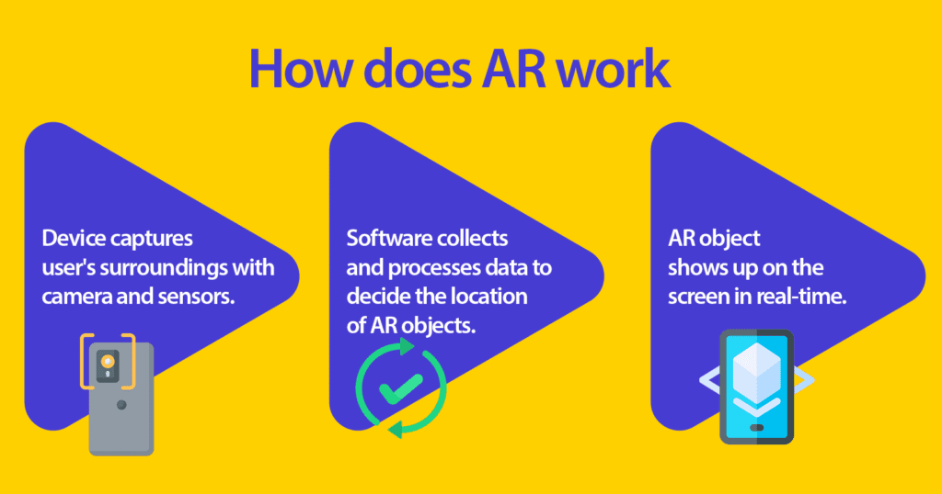

Slide 45
Cloud

Slide 46
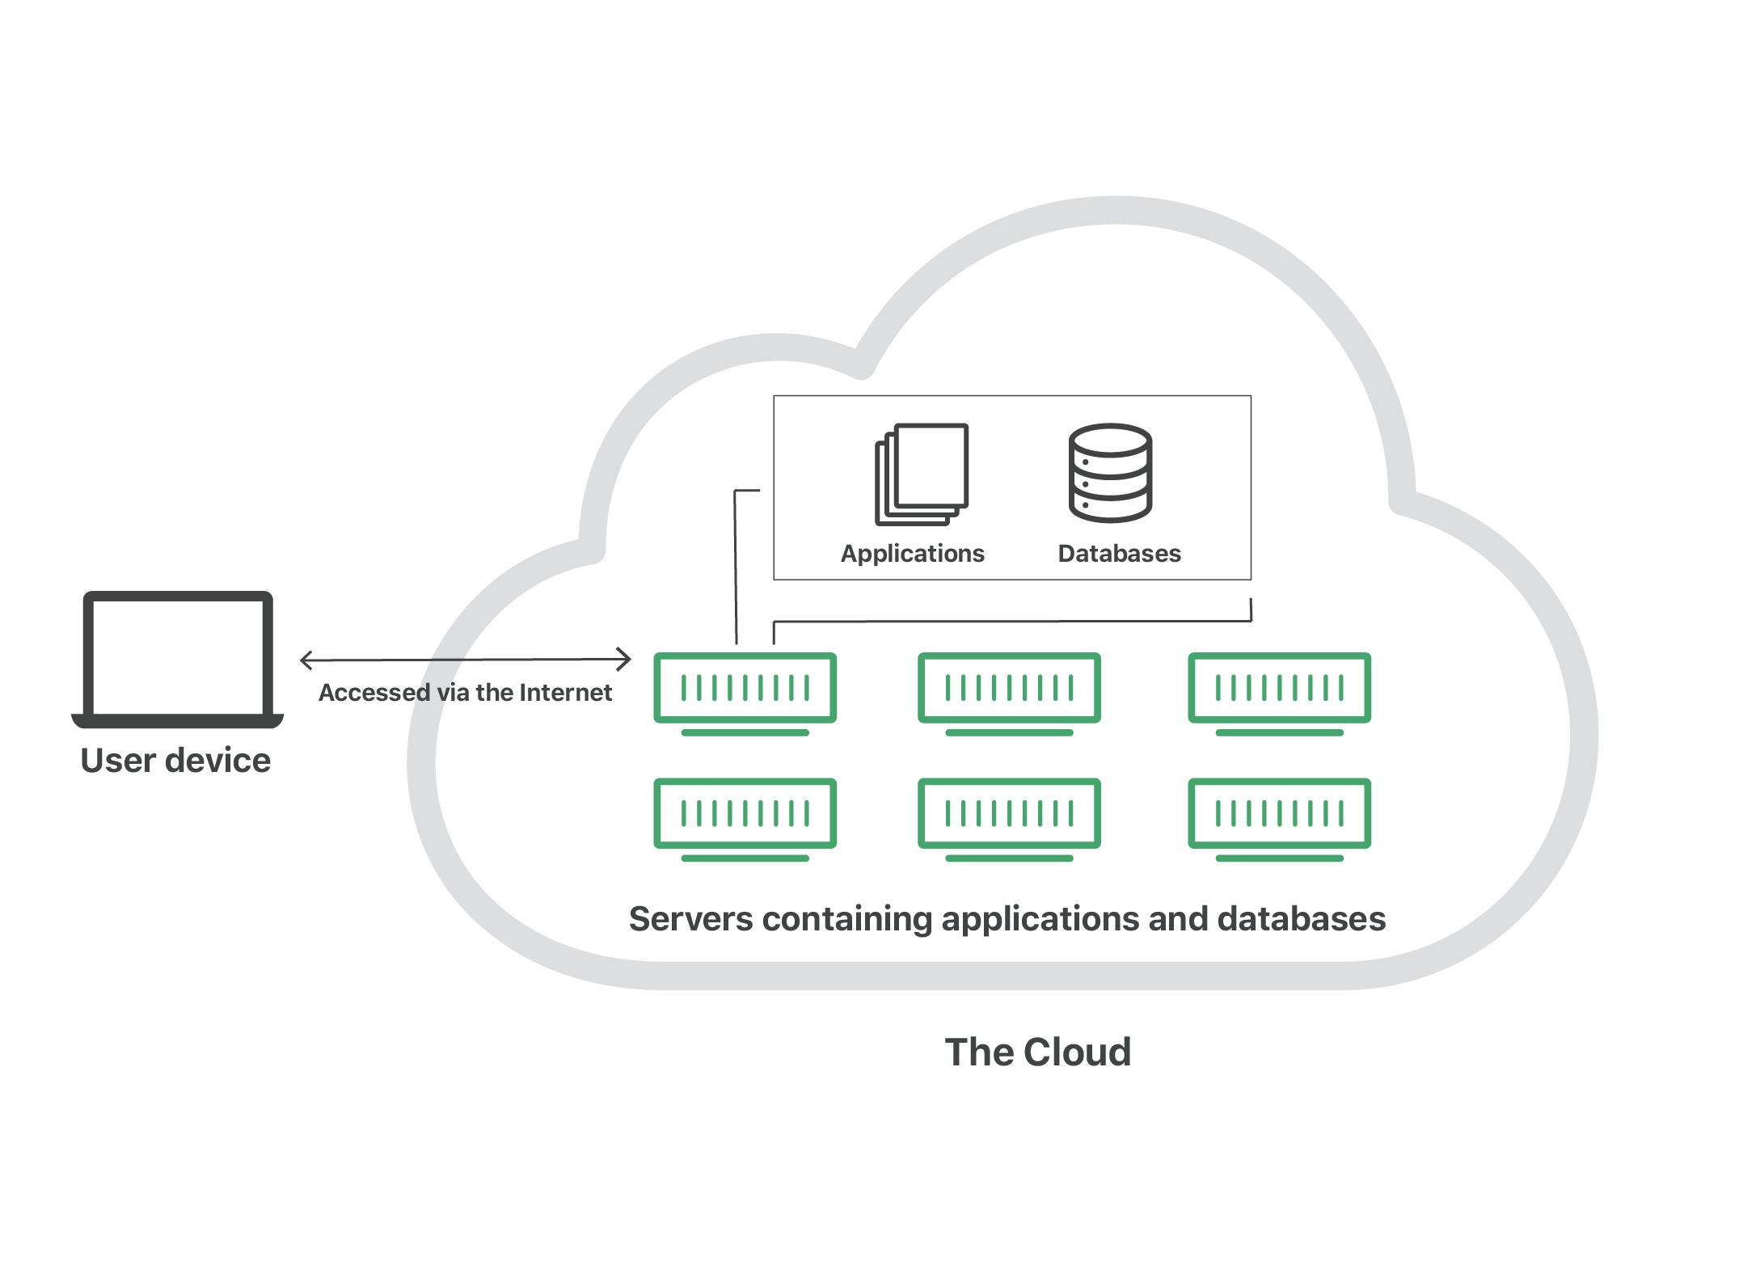
What is the cloud?

Slide 47
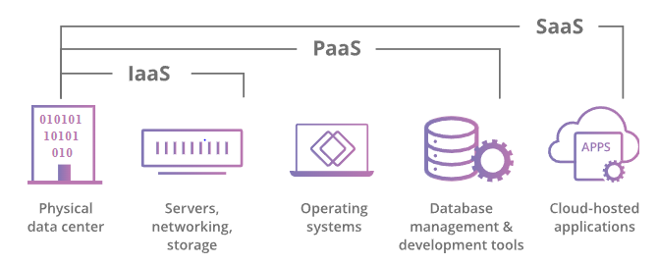
What are the main service models of cloud?

Slide 48
What are the different types of cloud deployments?
Private cloud
Public cloud
Hybrid cloud
Multi-cloud

Slide 49








Tools and Technology

Slide 50
3. Requirements and Analysis

Slide 51
UML Diagrams

Slide 52
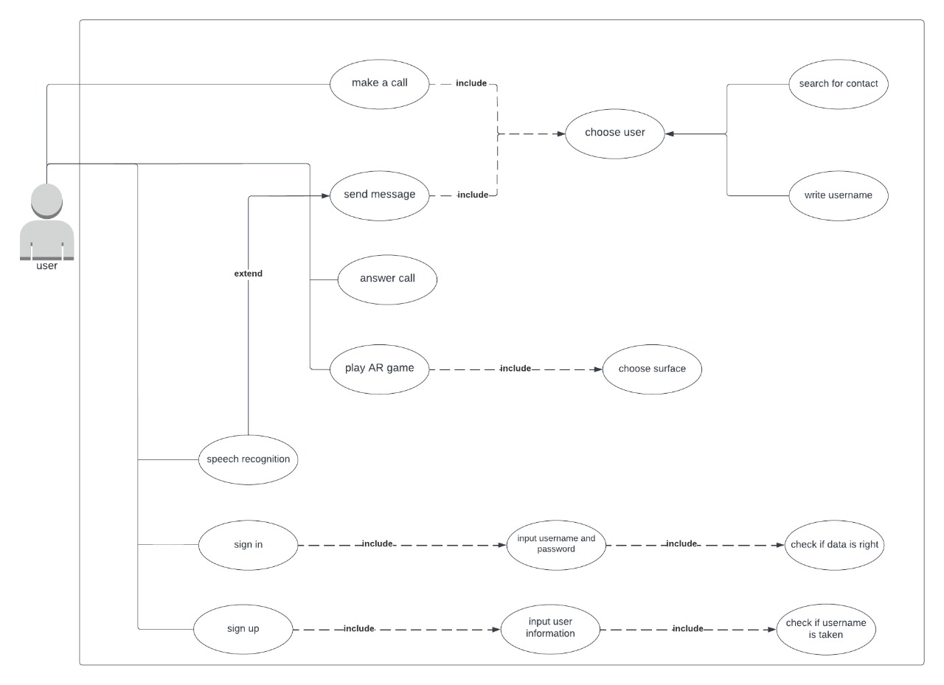
Use Case

Slide 53
Sequence Diagrams

Slide 54
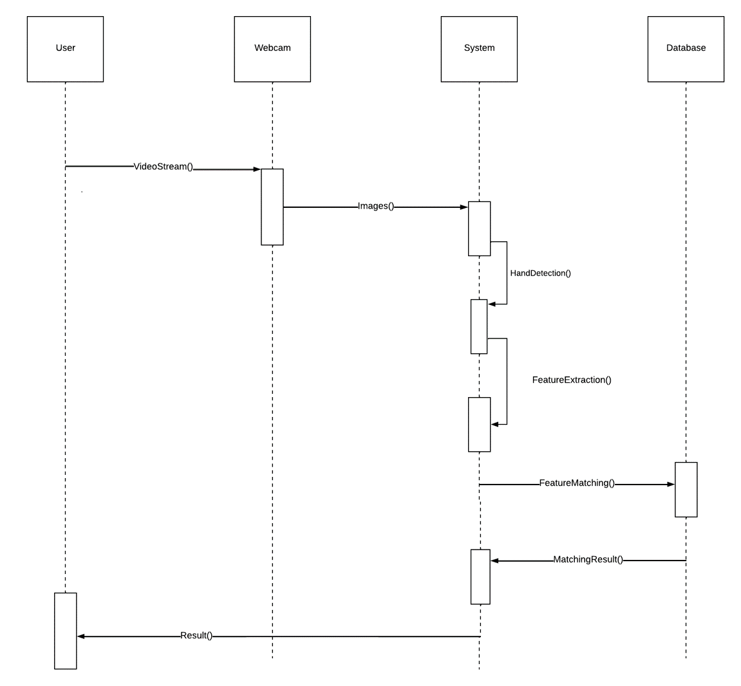
Gesture Recognition

Slide 55
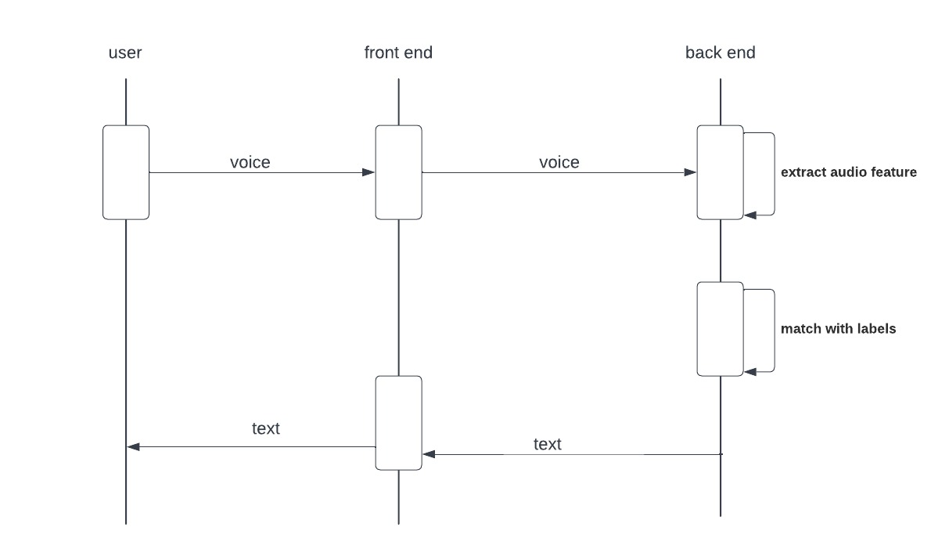
Speech Recognition

Slide 56
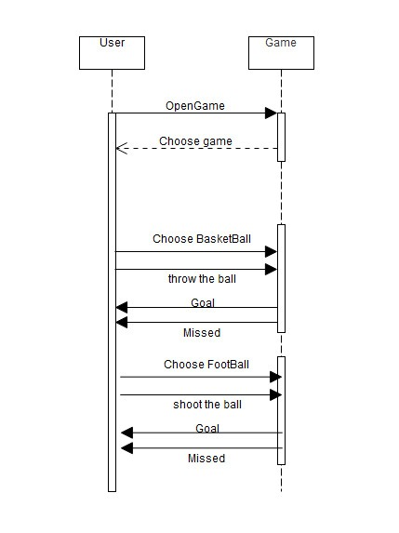
AR Game

Slide 57
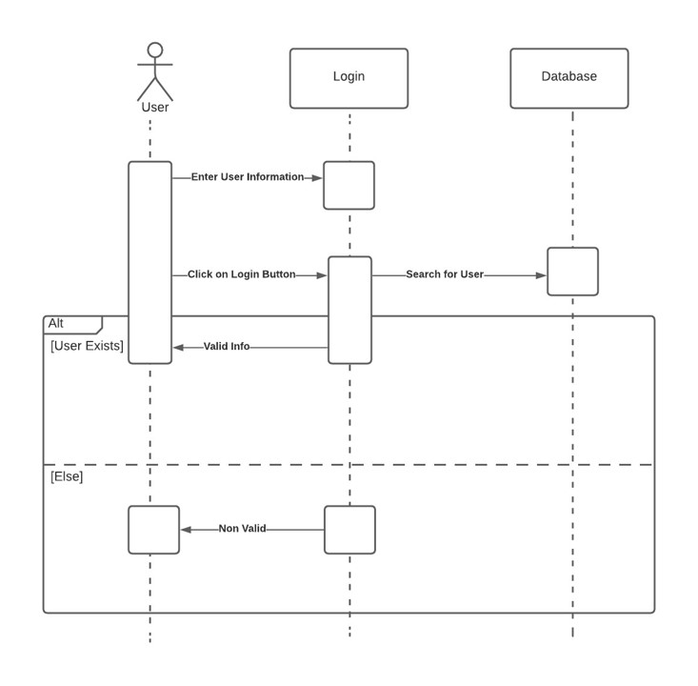
Log In

Slide 58
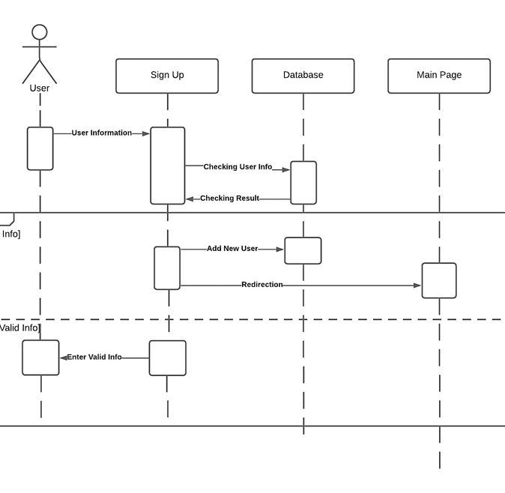
Sign Up

Slide 59
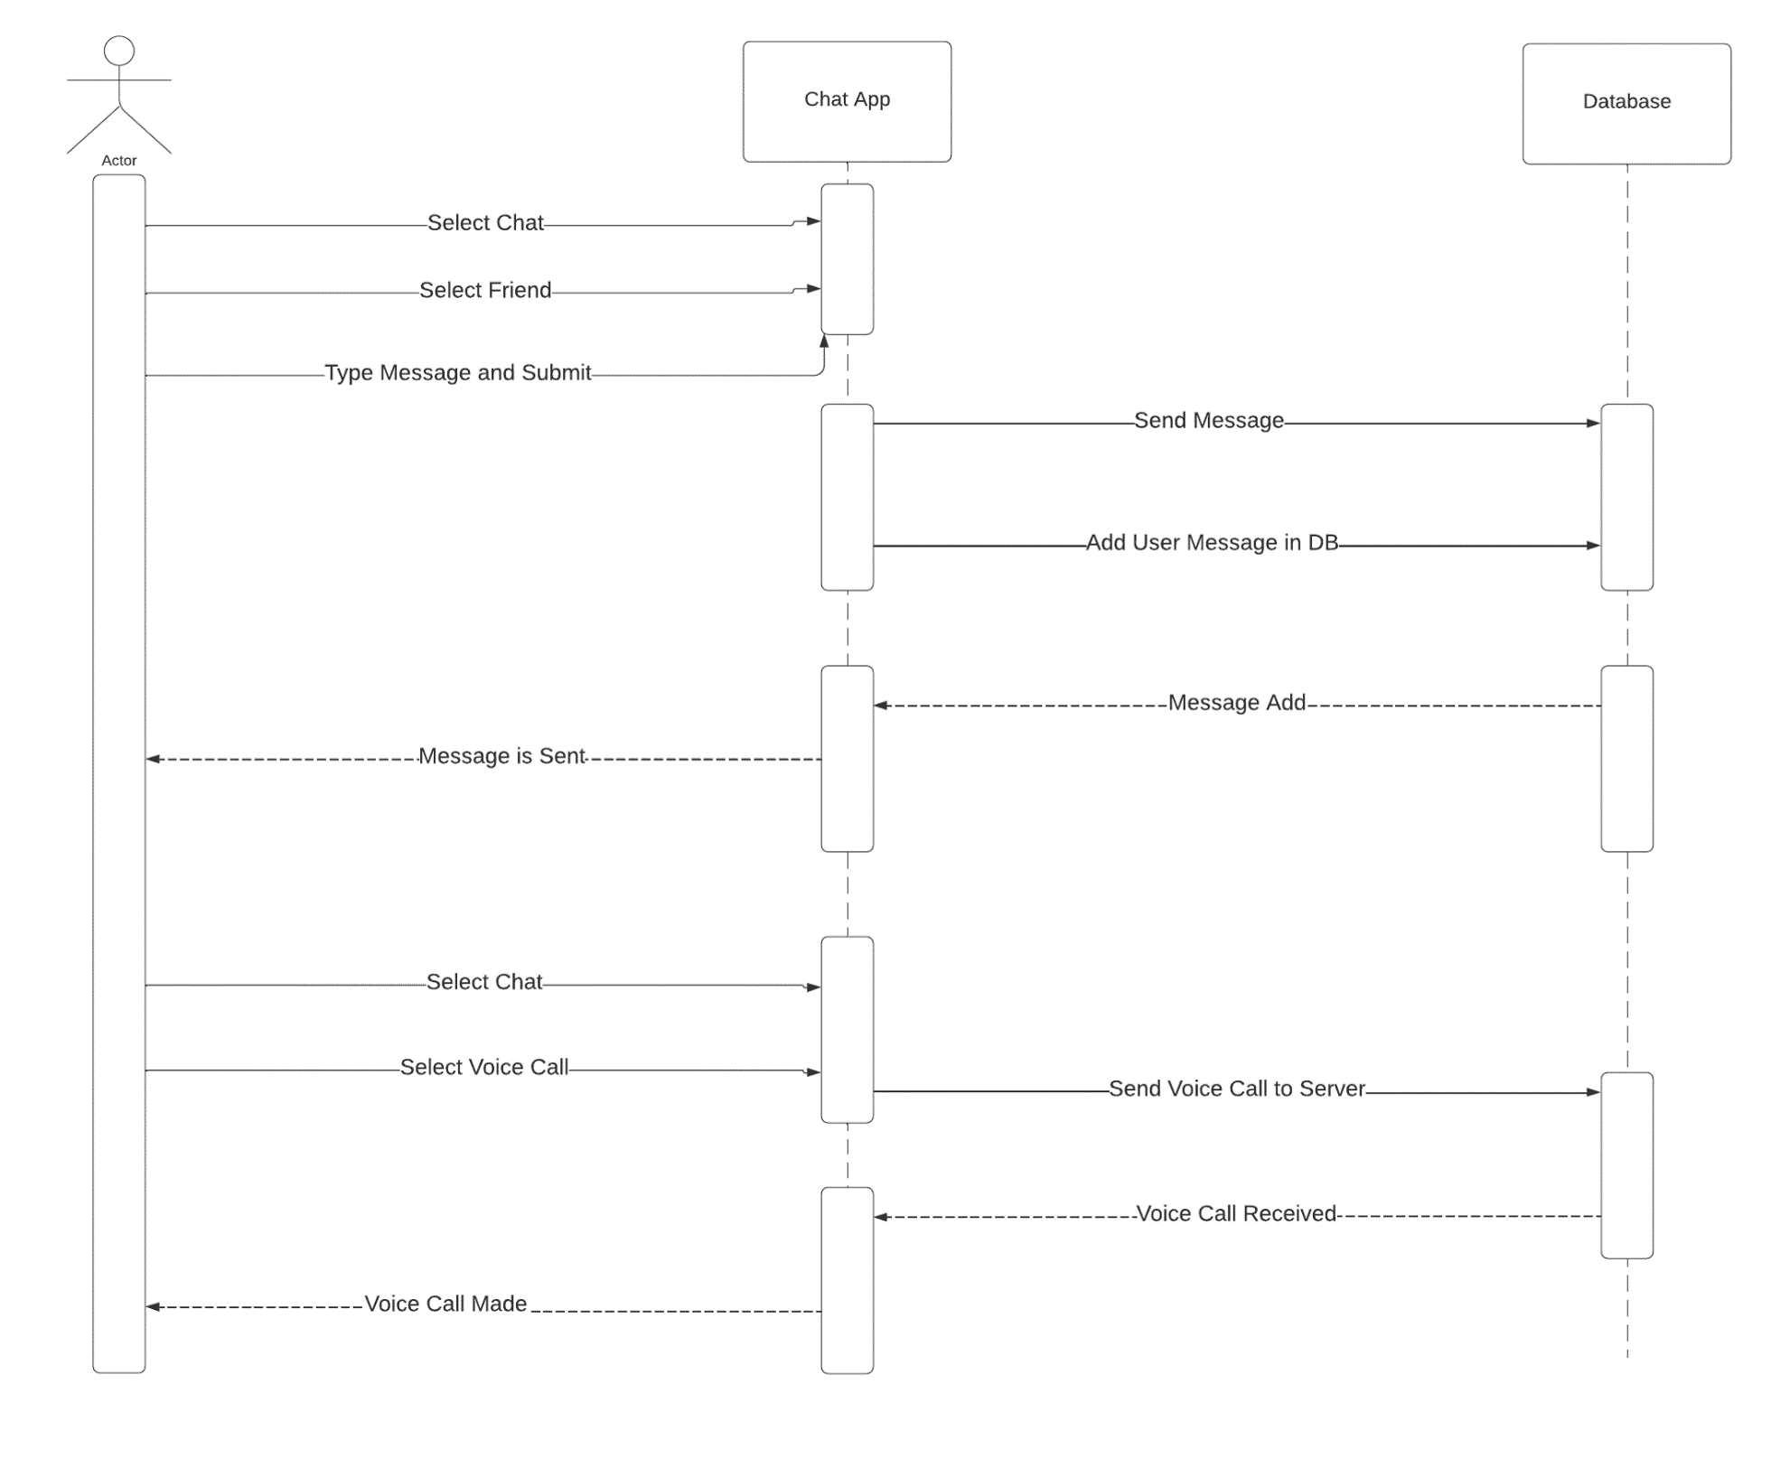
Chat

Slide 60
Class Diagrams

Slide 61
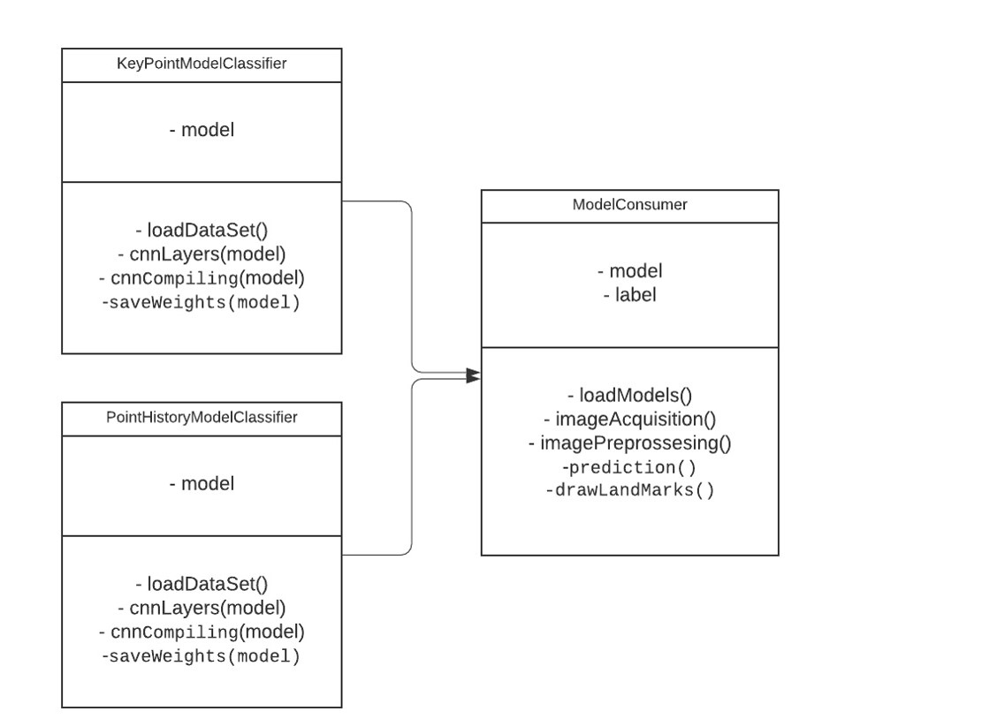
Gesture Recognition

Slide 62
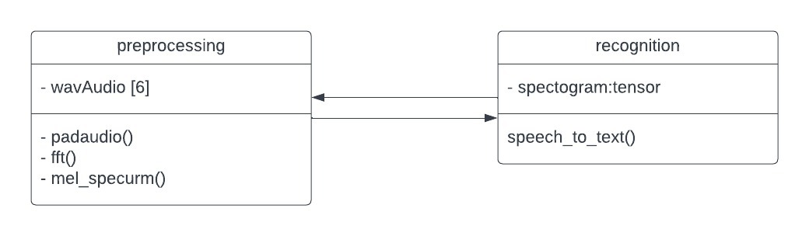
Speech Recognition

Slide 63
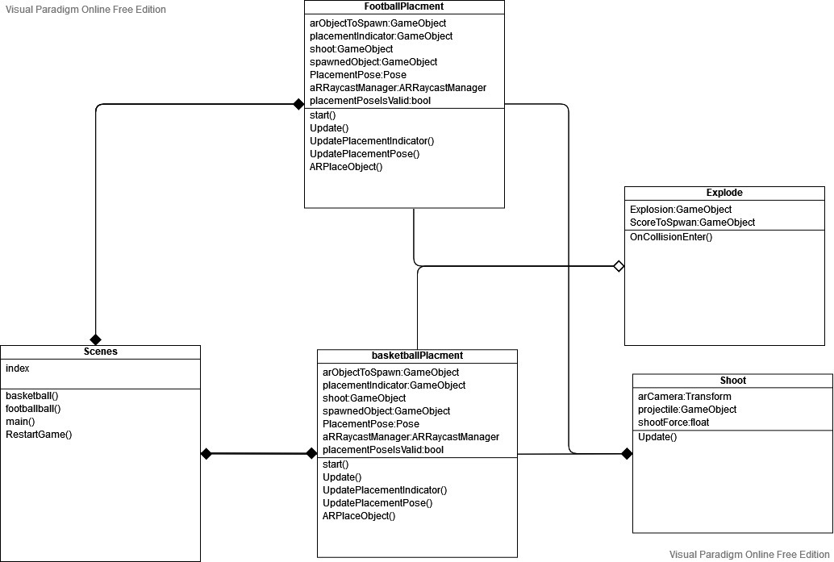
AR Game

Slide 64
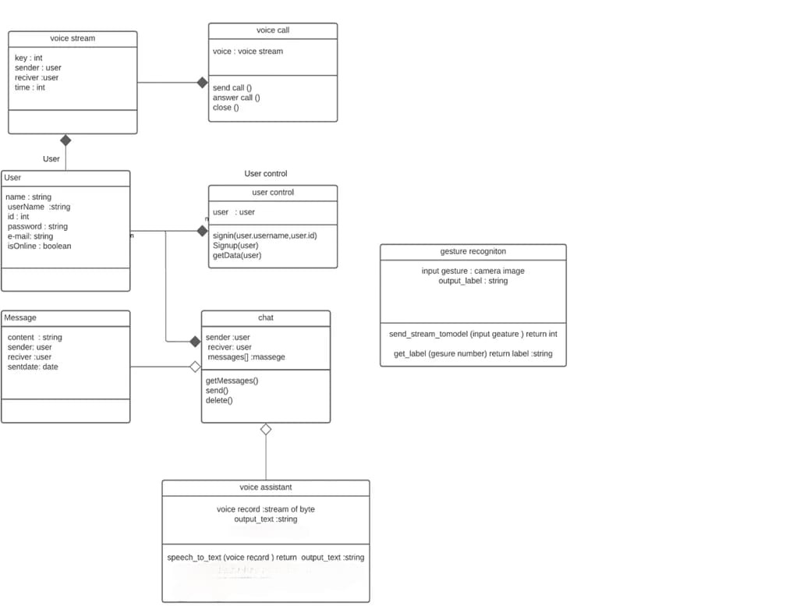
Frond End

Slide 65
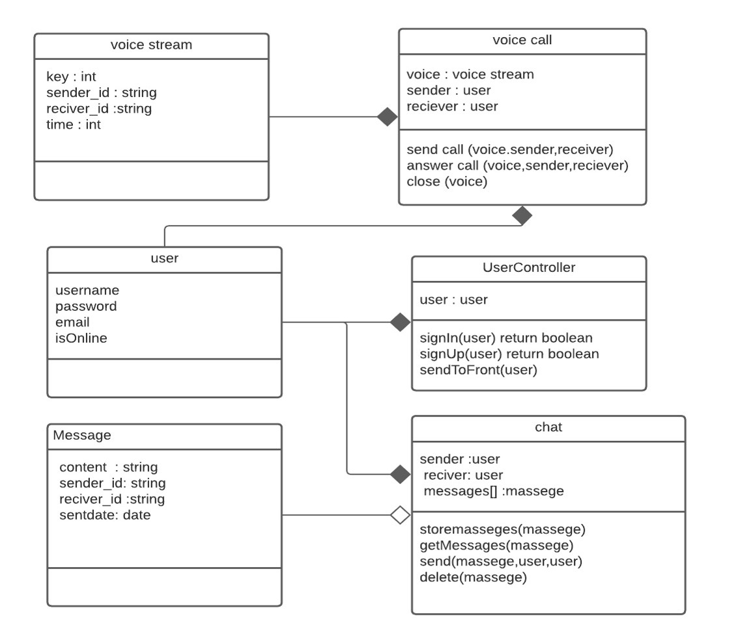
Authentication and Chatting (Back End)

Slide 66
Authentication and Chatting (Back End)

Slide 67
Software Development Methodology

Slide 68
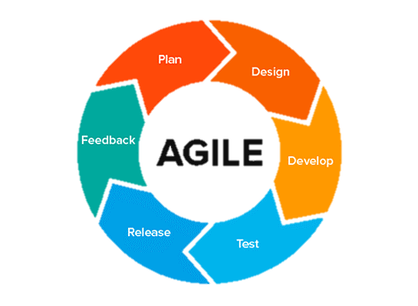
We follow in this project Agile Development Methodology
Why
Benefits

Slide 69
Why:
Working software important than documentations.
Responding to change over following a plan.
To implement a new feature the developers need to lose only the work of a few days, or even only hours, to roll back and implement it.
Organizations that have adopted Agile methodologies are able to respond to market dynamics and complete more of their projects successfully.

Slide 70
Benefits:
Deliver software frequently.
Working software the primary measure of progress.
Motivated Environment.

Slide 71
Requirement

Slide 72
Functional Requirement
Provide augmented reality UI
Interact with the system just hand gesture
Chatting
Ability to make voice call
Speech recognition (speech to text) to control the system
Augmented reality basketball game and shooting football game

Slide 73
Non-Functional Requirement
Performance
Availability
Extensibility
Portability
Reliability
Usability
Correctness
Instability

Slide 74
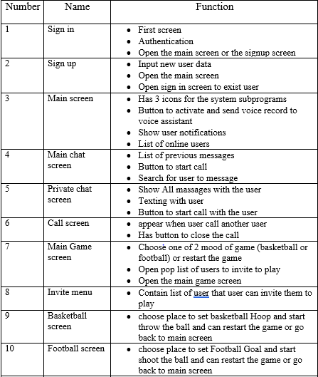
GUI List

Slide 75
Feasibility Study

Slide 76
1. Technical feasibility a) The goal of our application is find software solution, we don’t need any external hardware ,just android smartphone. b) our team is familiar with the deep learning concepts, flutter and cloud concepts too c) project size will be large but not too large for mobile application. d) Most of systems are similar to our project is using hardware solution with the software 2. Economic feasibility a) Our application solve a very important problem which the cost of AR devices such as Heolense for example b) Provide software solution will reduce the cost of using system its UI based on gesture recognition 3. Conclusion There are some risks with build this project and by doing Feasibility study ,we assume that we have the ability to build this project , we have all the resources to make this from idea to complete real life system.

Slide 77
4. System Design

Slide 78
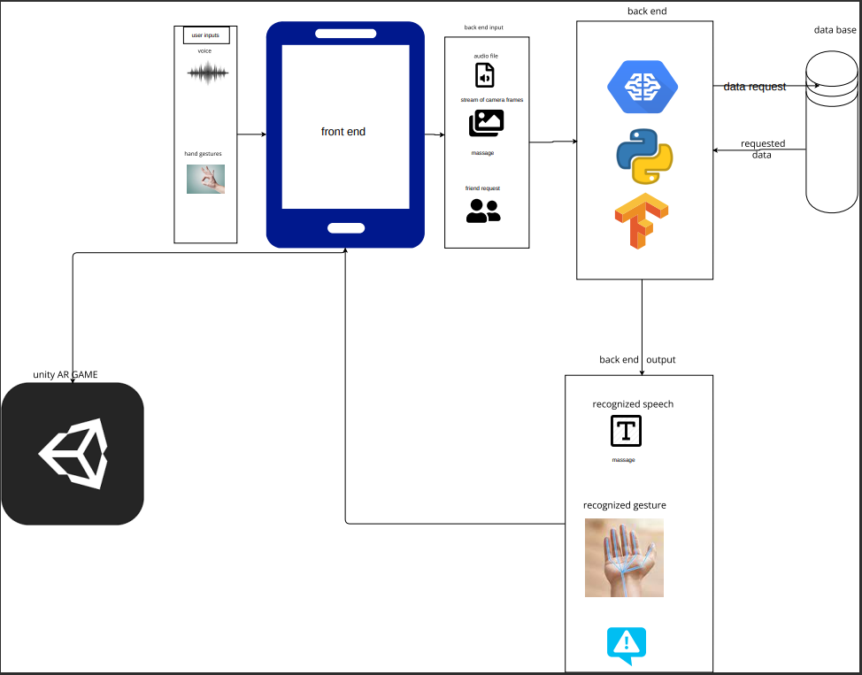
System Architecture

Slide 79
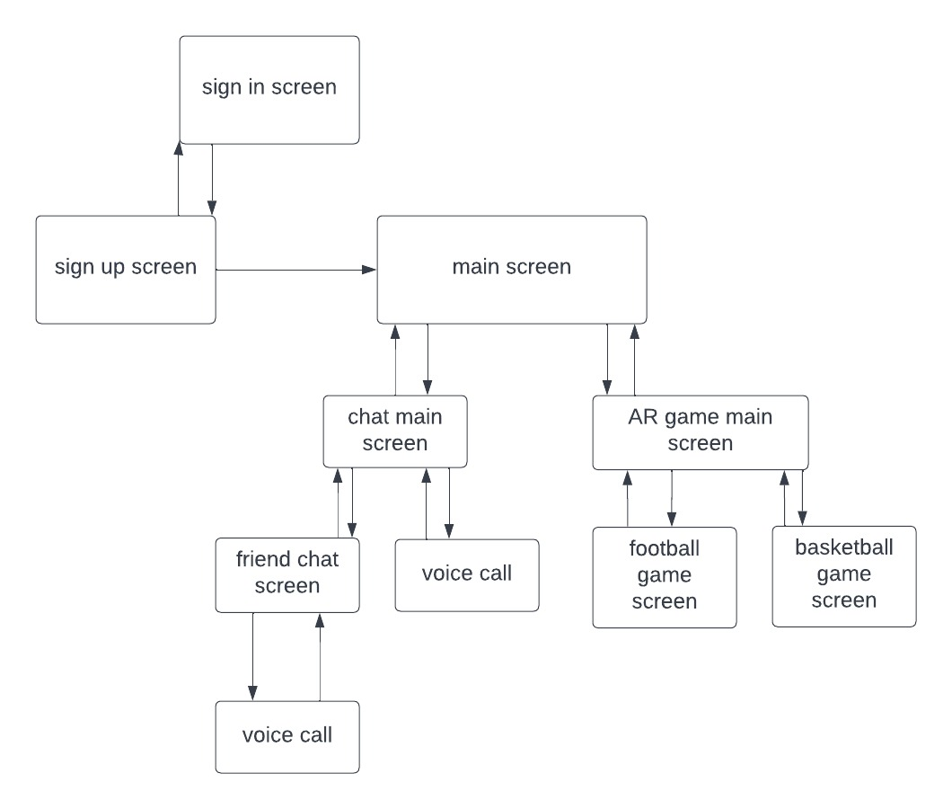
Site Mapping

Slide 80
UI Design

Slide 81
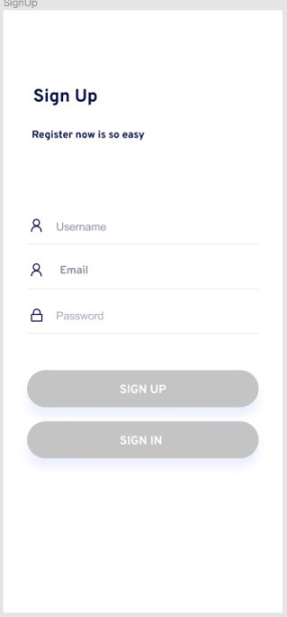
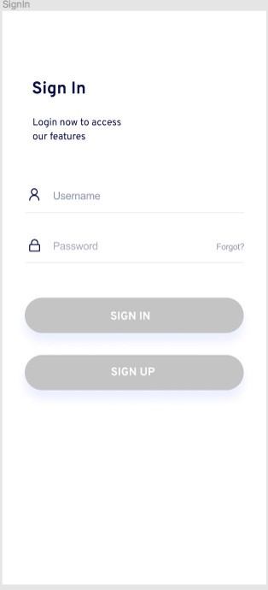
Sign In and Sign Up Screens

Slide 82
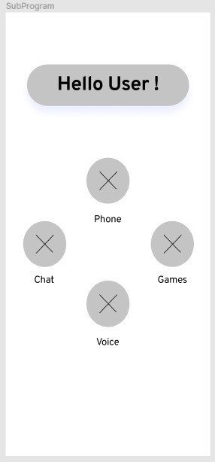
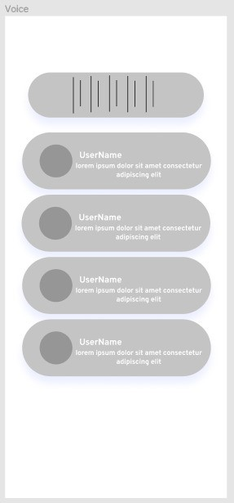
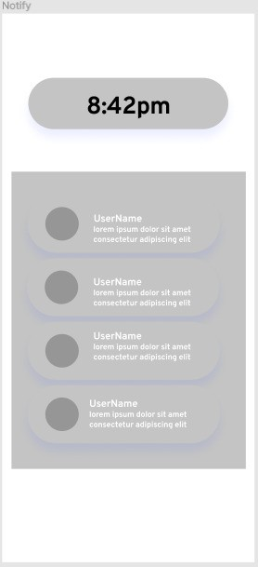
Main Screens

Slide 83



Chat Screens

Slide 84

AR Basketball

Slide 85
Software Design

Slide 86

Chat

Slide 87

Registration

Slide 88

Voice Call

Slide 89

Create Message

Slide 90

Retrieve Chat Content

Slide 91

AR Game

Slide 92

CNN model for gesture recognition

Slide 93

Gesture Recognition

Slide 94


Slide 95

CNN model for speech recognition

Slide 96

Speech Recognition Training

Slide 97

Speech Recognition Testing

Slide 98
Data Base Design

Slide 99

Entity Relationship Diagram

Slide 100

Schema

Slide 101
5. Implementation

Slide 102
Demo Video

Slide 103


Slide 104
6. Testing

Slide 105
Gesture Recognition

Slide 106


Problem 1 : varying lightning conditions and different backgrounds
Solution : open camera auto flash mode

Slide 107


Problem 2 : occlusions due to interaction with objects
Solution : open camera auto focus mode

Slide 108
AR Game

Slide 109


Problem 1 : shooting infinity balls in one second
Solution : putting timer in shooting script and make it on variable

Slide 110


Problem 2 : balls after throw it goes under ground
Solution : putting small ground under the basketball hoop or under goal and make it transparent

Slide 111


Problem 3 : Hoop and ball size ratio Real size was too hard and my size was too unrealistic
Solution : Get real size and make it easier by make ball smaller

Slide 112
Speech Recognition

Slide 113

Testing of separate words

Slide 114

Testing of whole sentence min silence =400ms and dbfs = -16

Slide 115

Testing of whole sentence min silence =190 ms and dbfs = -30

Slide 116
Conclusion

Slide 117


Slide 118

Speech to text training result
we train speech recognition model can
split the full voice record into smaller pieces
recognize words
build the sentence
accuracy of model is 91.2 % after 30 epoch

Slide 119


Gesture recognition training results:
Training Loss v/s Validation Loss with progress in epochs

Slide 120
Future Work
Voice assistant
Provide voice assistant to help the user control the system
Video chat
Make video chat meeting with more than one person
3d models
Add 3d objects to the augmented reality and interact with it
Multiplying games
Provide the ability to play with another user at the internet
Face recognition
Recognize the users from the camera and appear the information of their account behind them in augmented reality

Slide 121
Any Question !?

Slide 122
Thank You

